Slide 1

UXR Lightning Talk
6 pain points keeping Cx from enjoying Store rewards

Slide 2
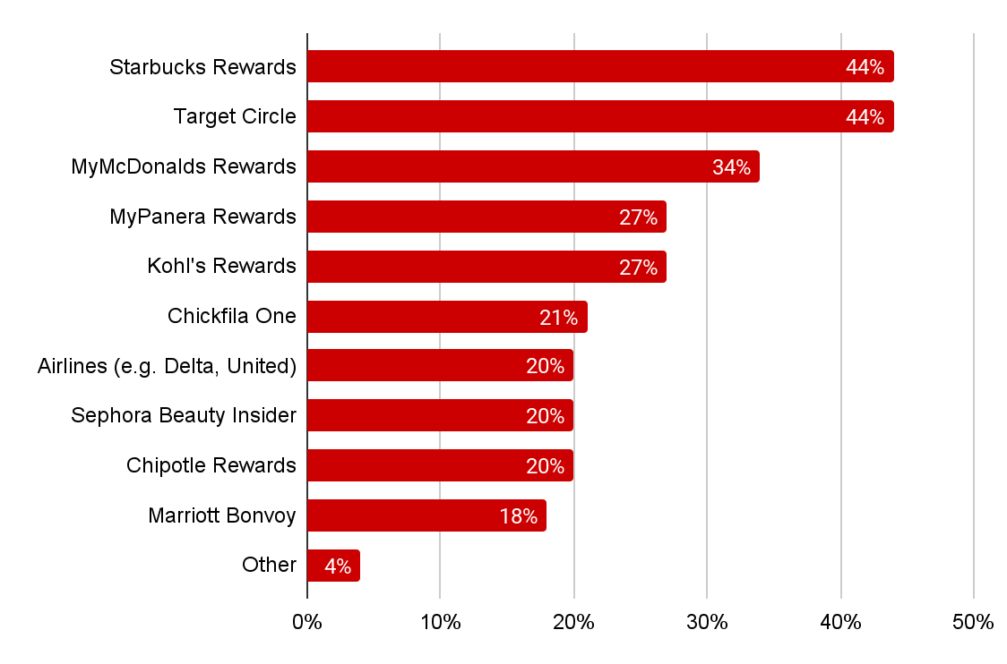
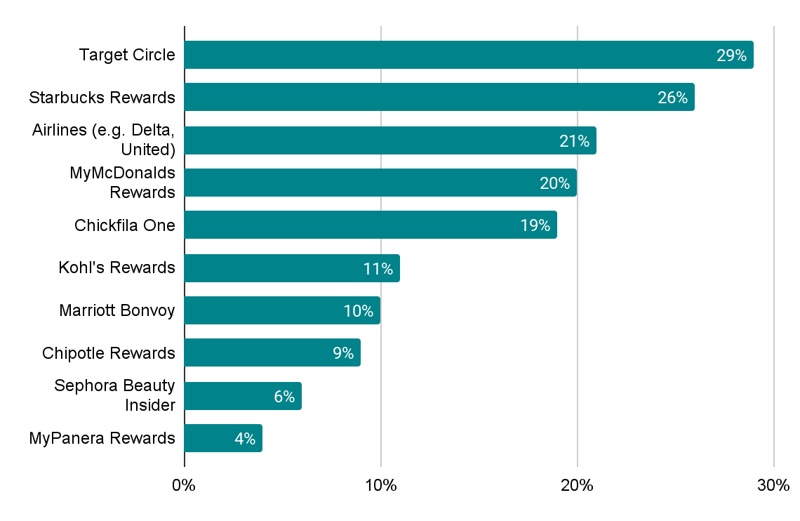
Pain point #1: Store rewards requires a major mindset shift from the typical loyalty experience/structure
Current Loyalty Programs Used
Loyalty Program Ranked #1
Average # of programs used= 2.79
See next slide for segment level differences
Do you currently participate in any of the following loyalty programs?
Earlier you stated that you participate in the following loyalty programs. Please rank these programs from those that are most valuable to you, to those that are least valuable to you.
Total N=2708, Power Cx n=571, Habit Cx n=256, Core Net Savers n=575, Dormant Cx n=164, Low Net Saver n=262, Net Loser n=352, Early Paid Subs n=285, Trial Cx n=292

Slide 3

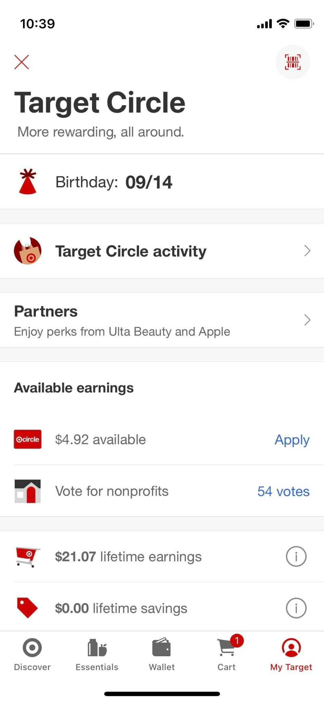
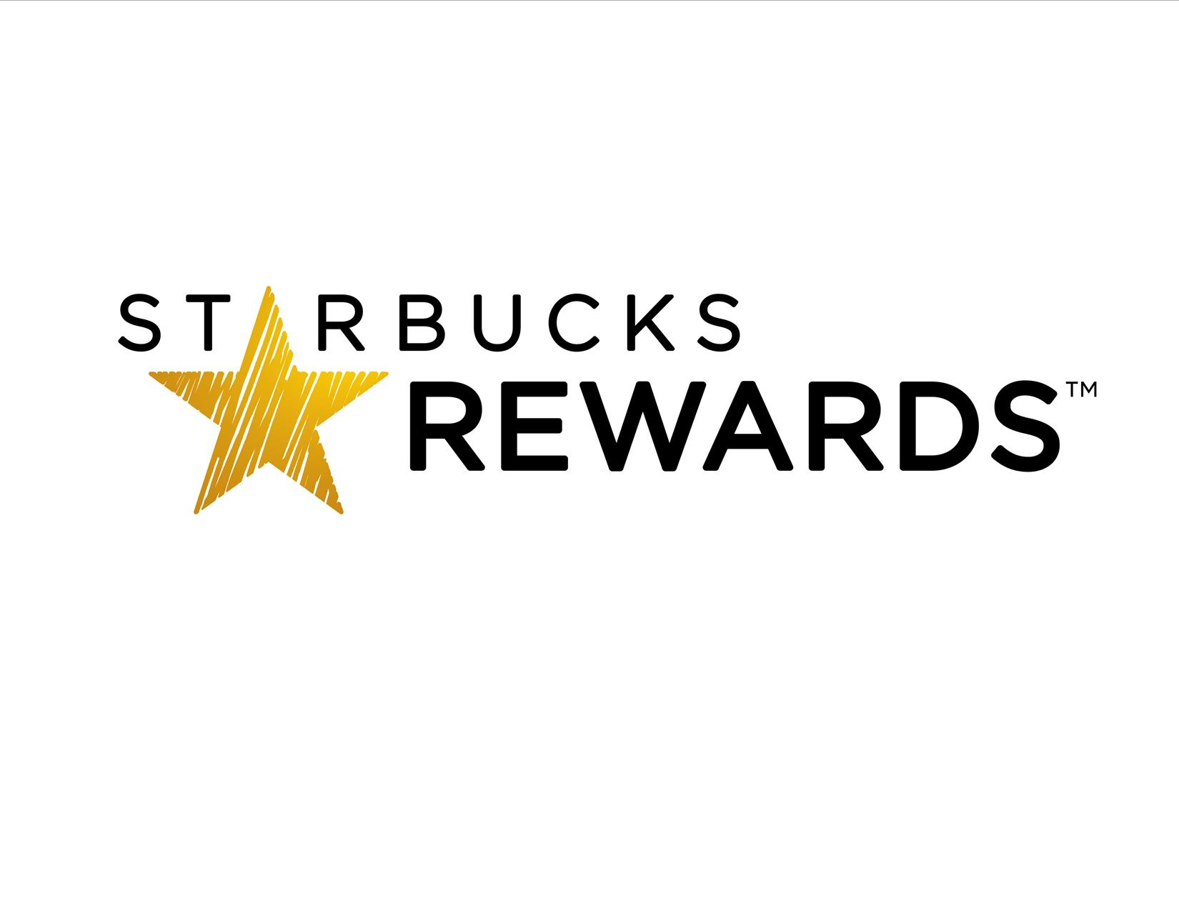
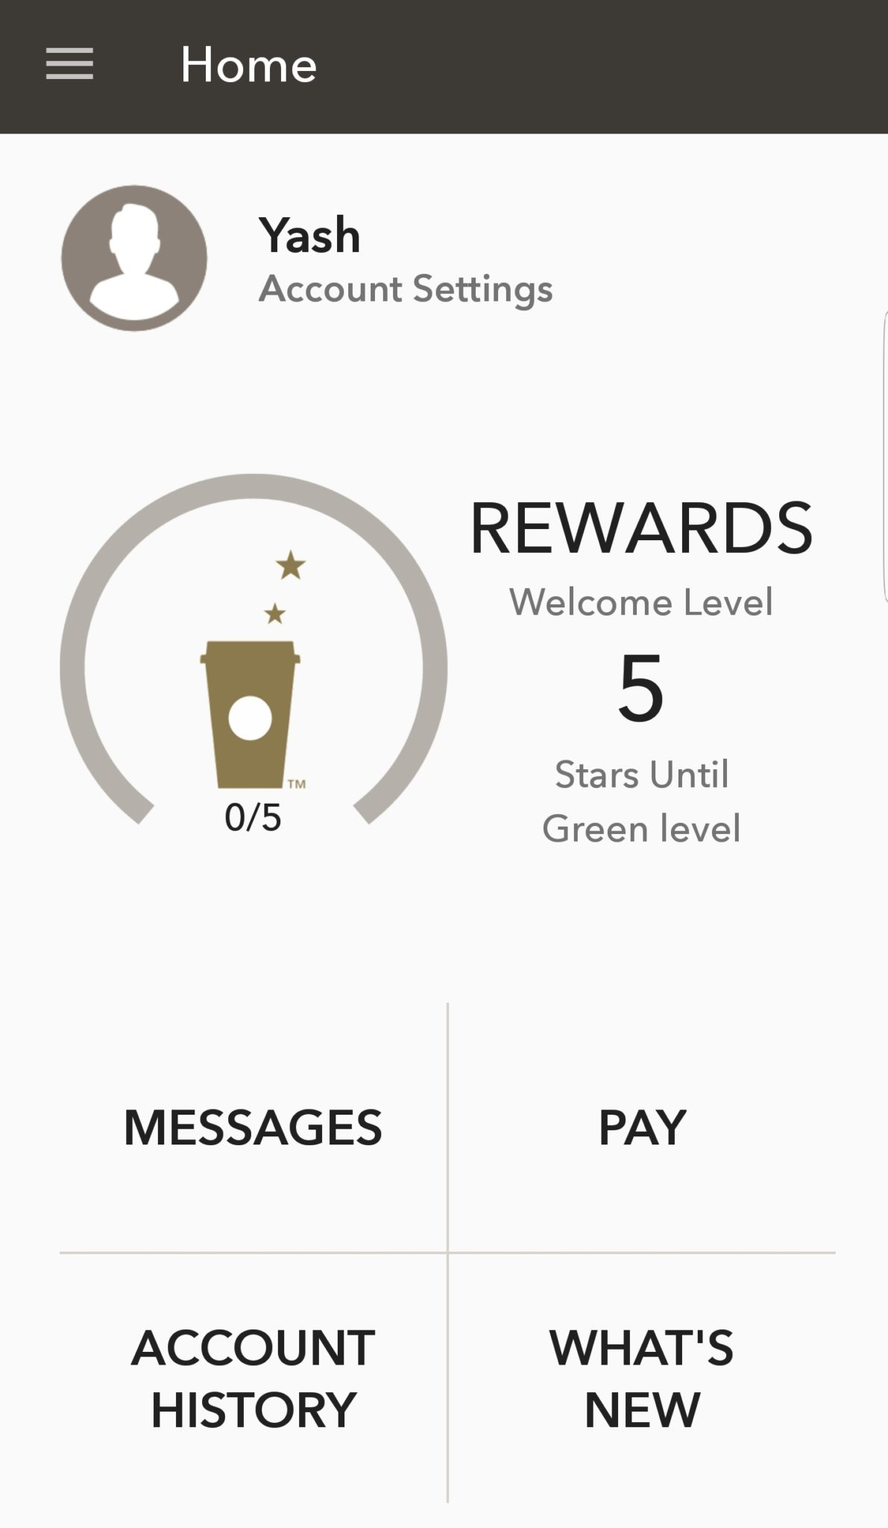
Earning monetary rewards quickly drives Cx satisfaction with Target & Starbucks loyalty programs
Cash back/ discounts
Accumulate rewards quickly
Frequent deals/ coupons
Easy to see rewards & savings
Free food/frequent discounts
Rewarded frequently/for every dollar
Daily coupons
Free drink on birthday
Thinking about the loyalty programs you ranked highly, what benefits, features or experiences make them stand out?
Total N=2708

Slide 4
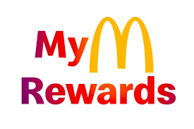
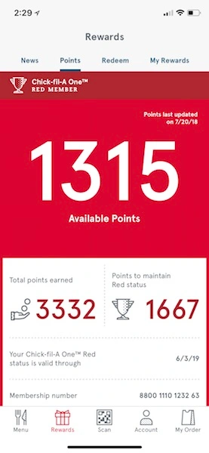
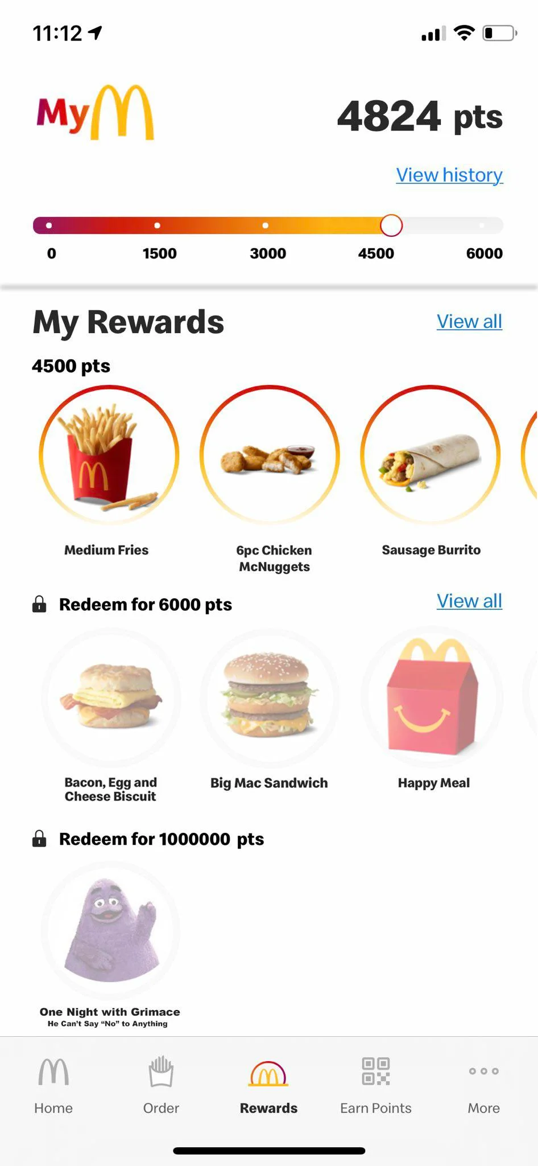

Top restaurant apps are successful because you “earn” with every order and get full free meals in return
Accumulate rewards quickly
Discounts
Free fries
Earn rewards on every order
Free food
Easy to cash in
Thinking about the loyalty programs you ranked highly, what benefits, features or experiences make them stand out?
Total N=2708

Slide 5
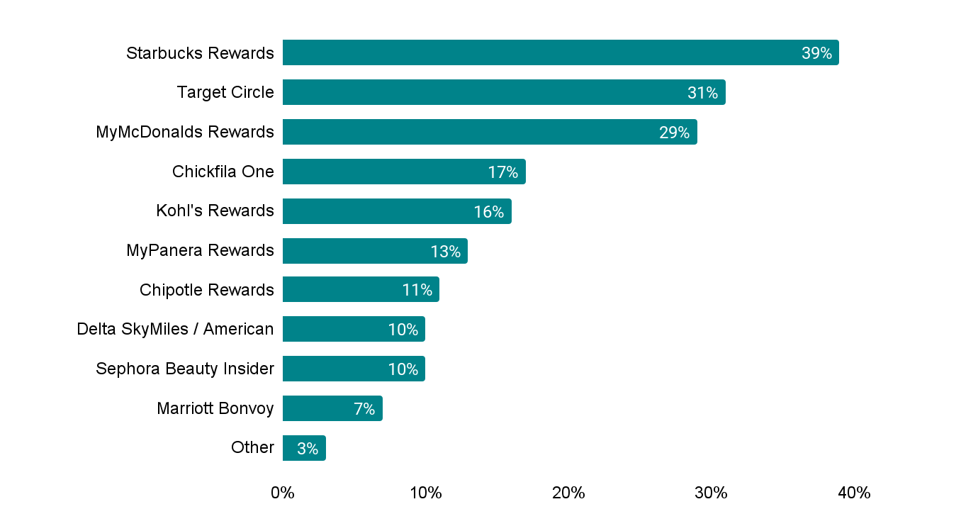






Unclear and ever changing rules can discourage Cx from active loyalty participation
Most clear/easy to understand programs
What makes a program unclear?
 | Don’t use it enough
 | Changing guidelines/restrictions/fine print
 | Difficult to cash in on rewards
 | Requirements to cash in/get to next tier are confusing
 | Some locations do not participate
 | Frequent app glitches/errors/updates
Earlier you stated that you participate in the following loyalty programs. Please select the programs that you find the most clear/easy to understand. Please select up to 3 responses.
Thinking about the loyalty programs that you did not select as most clear/easy to understand, what makes them confusing or difficult at times?
Total N=2708, Power Cx n=571, Habit Cx n=256, Core Net Savers n=575, Dormant Cx n=164, Low Net Saver n=262, Net Loser n=352, Early Paid Subs n=285, Trial Cx n=292

Slide 6

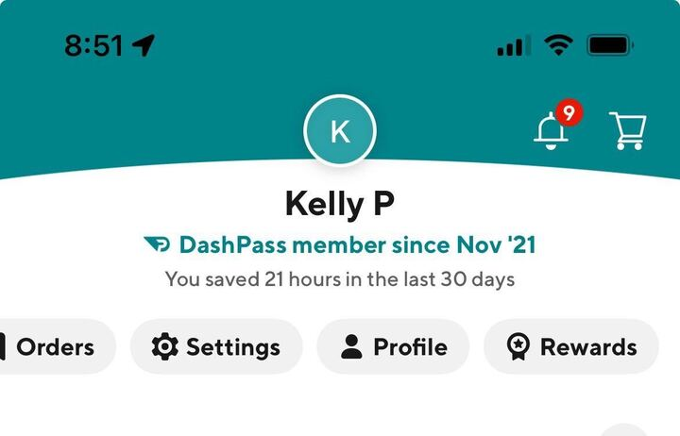
Pain Point #2: Awareness- The majority of Cx are not aware of store rewards
No Cx recalled the store rewards program in qualitative research conducted in 2023 & 2024
In most recent research, Cx were unaware of the MeTab, or the location of the rewards filter on the MeTab

Slide 7
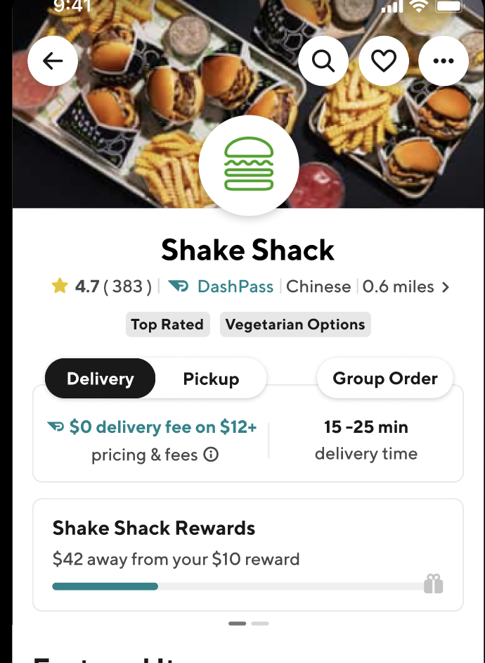
Pain Point #3: Perceived Achievability- Cx don’t feel like they can reach the required reward
“I’m never going to order $150 dollars worth of food at this store. It’s just me, maybe if I was ordering with a group”
“Spend $100 to get $5, that’s just not worth it”

Slide 8


Pain Point #4: Not a memorable experience
When Cx see/interact with rewards they do not typically remember seeing them. This is due to the barriers listed above including perceived achievability and lackluster rewards.
Because they do not remember seeing this content, they do not actively look for progress or other rewards offers.

Slide 9
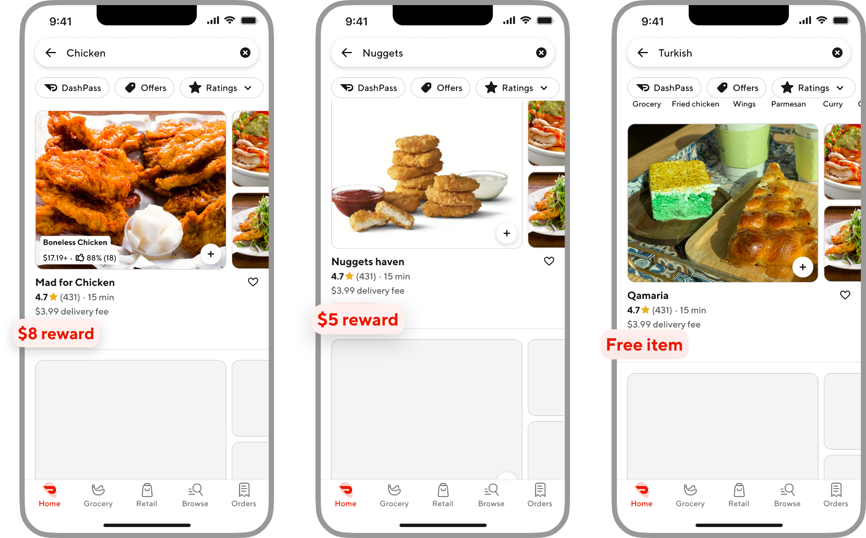
Pain Point #5: Inconsistent communication & timing
Different Mx offer different rewards structures and experiences. This makes it more difficult for Cx to notice when there is a difference or to understand how the rewards experience works.

Slide 10
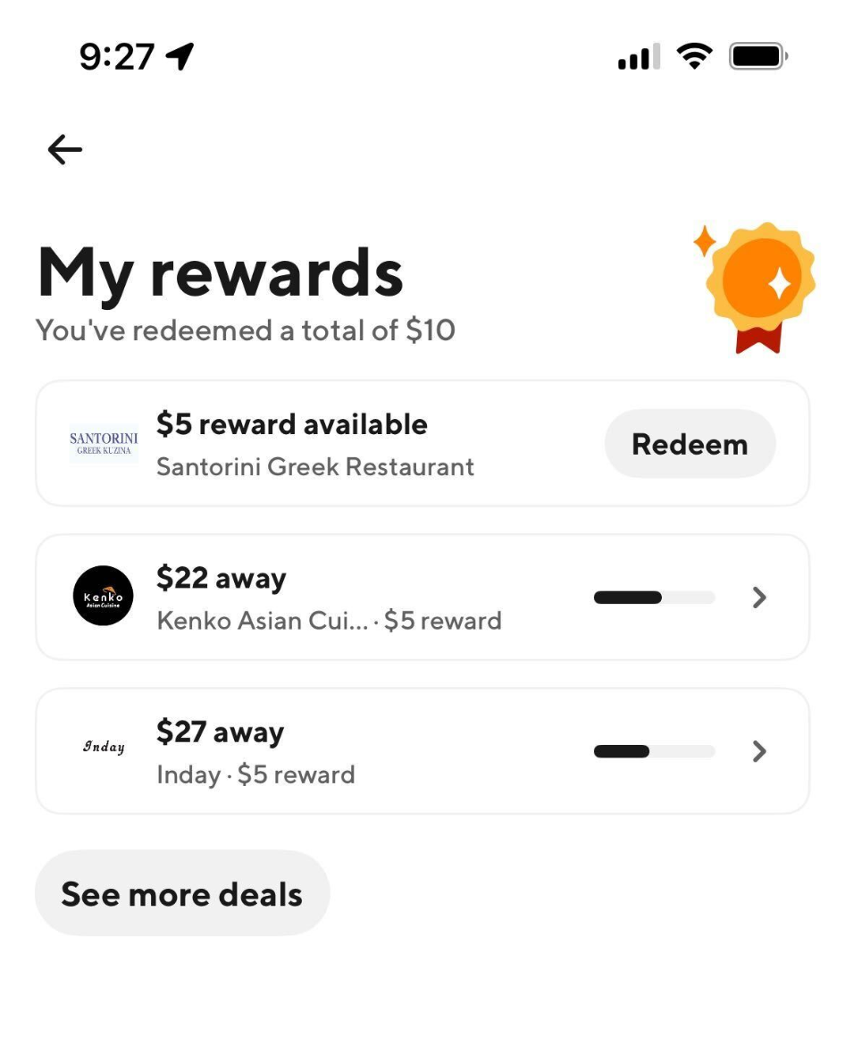

Pain Point #6: No excitement around earnings
There are no exciting/fun/enticing/engaging interactions in the app when you earn towards rewards or even unlock a reward. Nothing makes progress stand out to Cx. There isn’t even an option to add it to your cart automatically.

Slide 11




So…how can we improve store rewards?
UXR recommends focusing on:
Clarity | It needs to be clear to Cx that something is a store reward vs. a promo. It needs to be clear how to earn and when to redeem. It needs to be clear which stores offer rewards.
Timing/Interception | Communication of rewards may need to vary depending on progress. We cannot expect Cx to seek this out, we must bring it to them in a consistent way.
Achievability | Rewards must feel achievable and motivating. The prize needs to make sense, and the pathway there needs to feel fair. Progress should feel consistent, not stagnant.
Celebration | Cx should feel their progress whenever they place an order in an exciting and memorable way. Reaching a reward should be thrilling.

